Slide 1
Update on TORC1 and TORC2 Phylogenetics
Kyle Johnson, Dellaram

Slide 2
Initial Thoughts Slide
Originally did by the following:
Parasites, Photosynthetic symbiotes, Ciliates
Found some out-lier organisms which are unicellular
In Stramenopiles, fairly uniform distribution of TOR Components
Rhizaria information is unreliable at current moment
Alveolata contained wide majority of parastic organisms

Slide 3
Continued Work
Expanded research parameters to include the following:
For Archaeplastida: Streptophyta, chlorophyta, rhodophyta
For Excavata: Discoba and Metamonada
Currently looking for more information about Rhizaria
Beginning SRA work to rule out/in some outlier species in all supergroups
Expanding the phylogenetic trees for the protein components

Slide 4
RAPTOR Results
RAPTOR found across all Super Groups
Major exception found within the Ciliates who lack entirely
Results indicate the presence of One RAPTOR at minimum. More likely (see A.thaliana)
Very clustered results. I.E. RAPTOR proteins tend to stay very close to Group

Slide 5
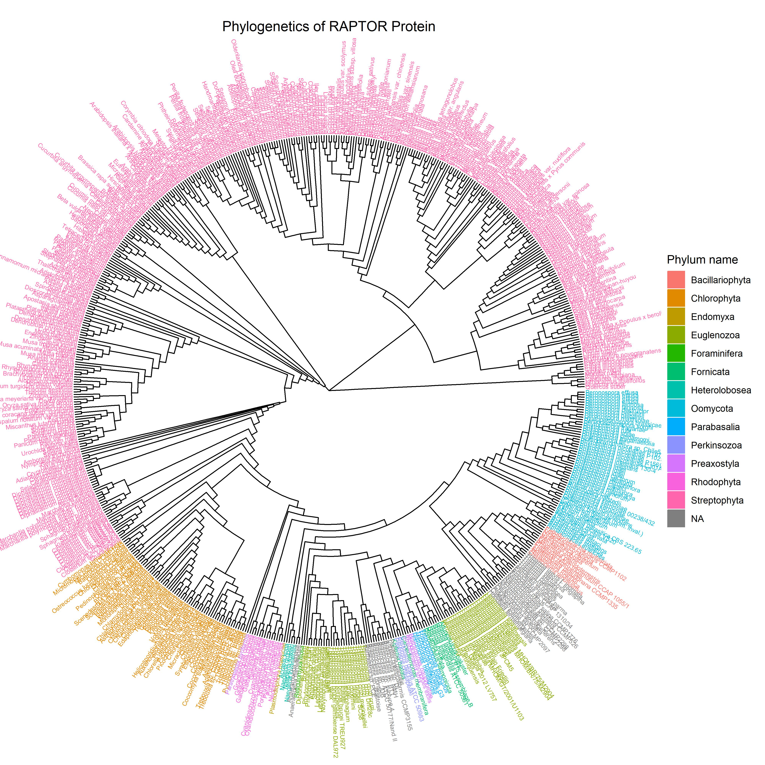
Combined RAPTOR Tree

Slide 6
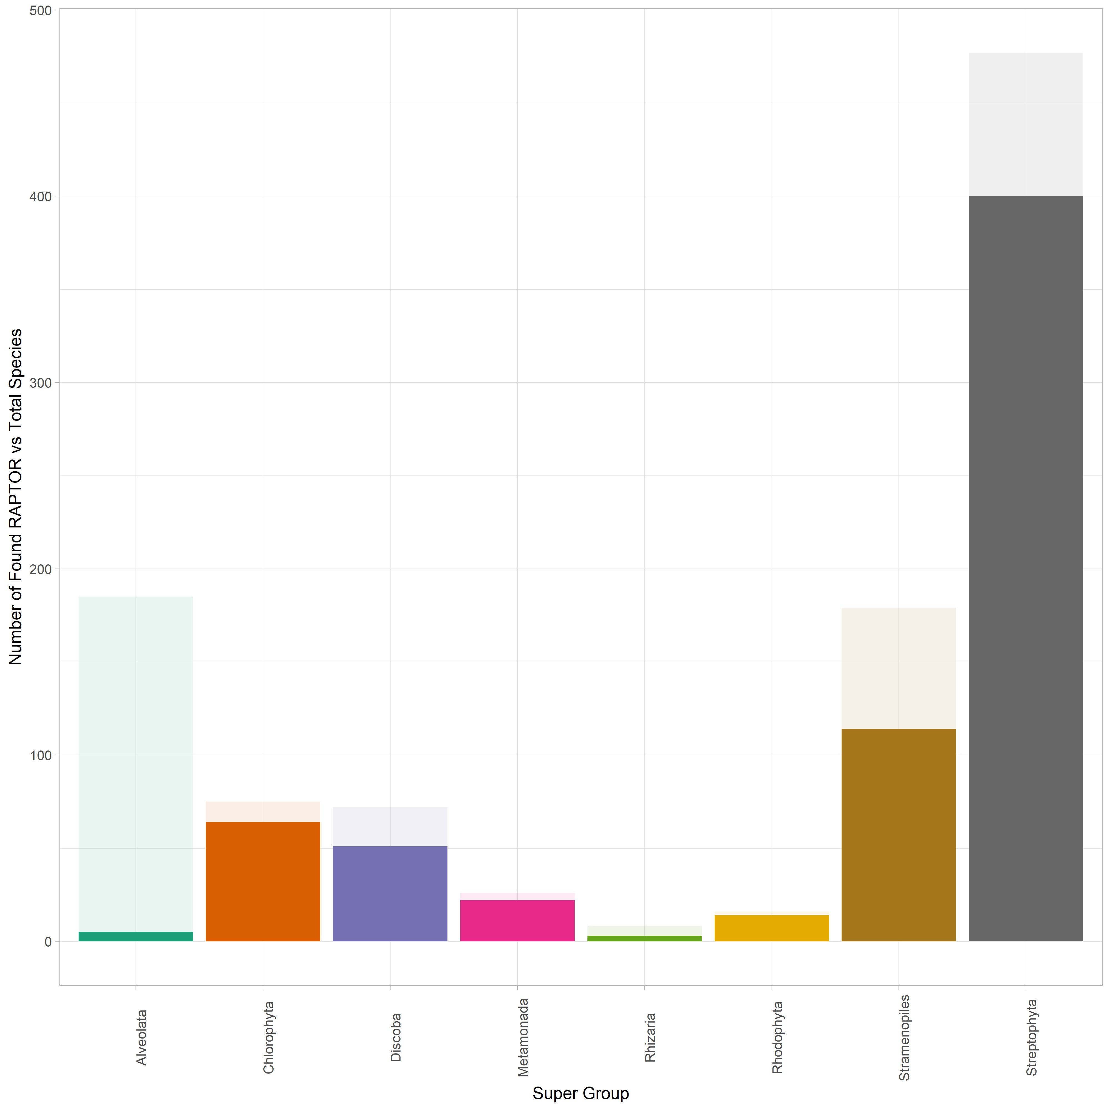
RAPTOR Relative to Total Species Surveyed

Slide 7
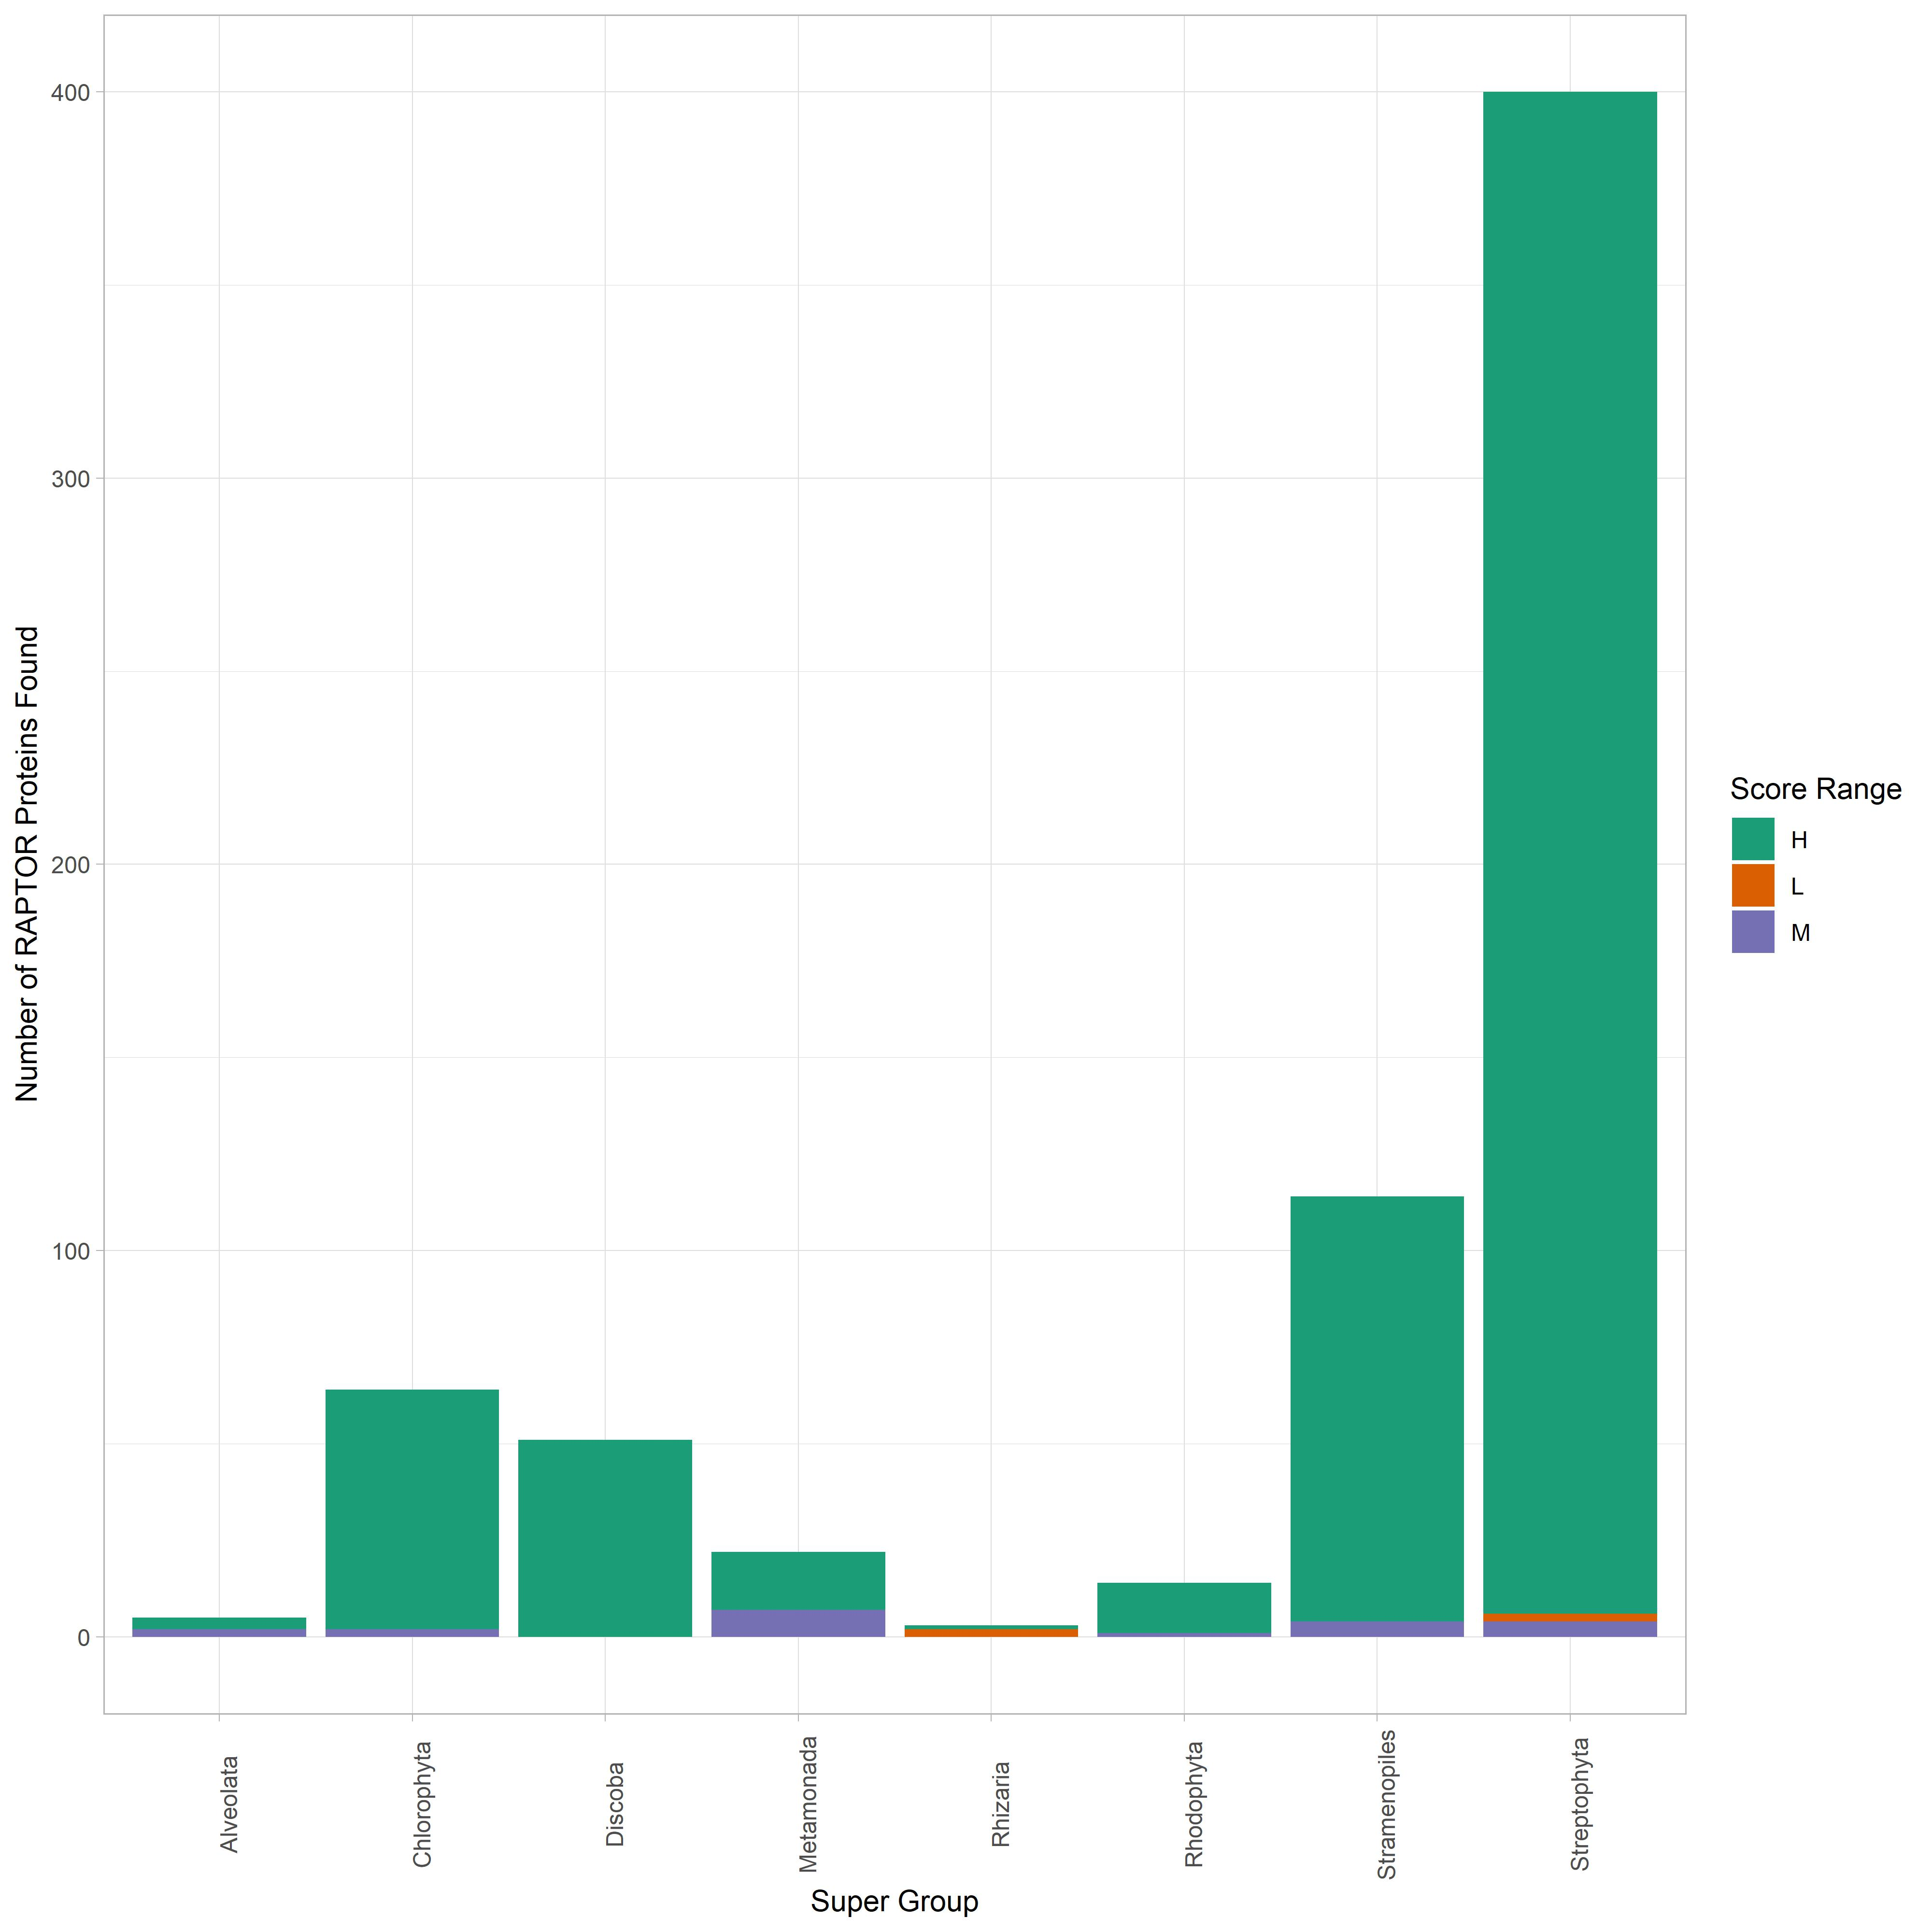
RAPTOR Score Distribution

Slide 8
RICTOR Results
RICTOR very prevalent across the different Super Groups
Found especially within the Excavates and the SAR Groups
Some hits were found in the Archaeplastida grouping
SRA analysis required to officially confirm presence
Possible issues with contamination in Streptophyta specifically

Slide 9
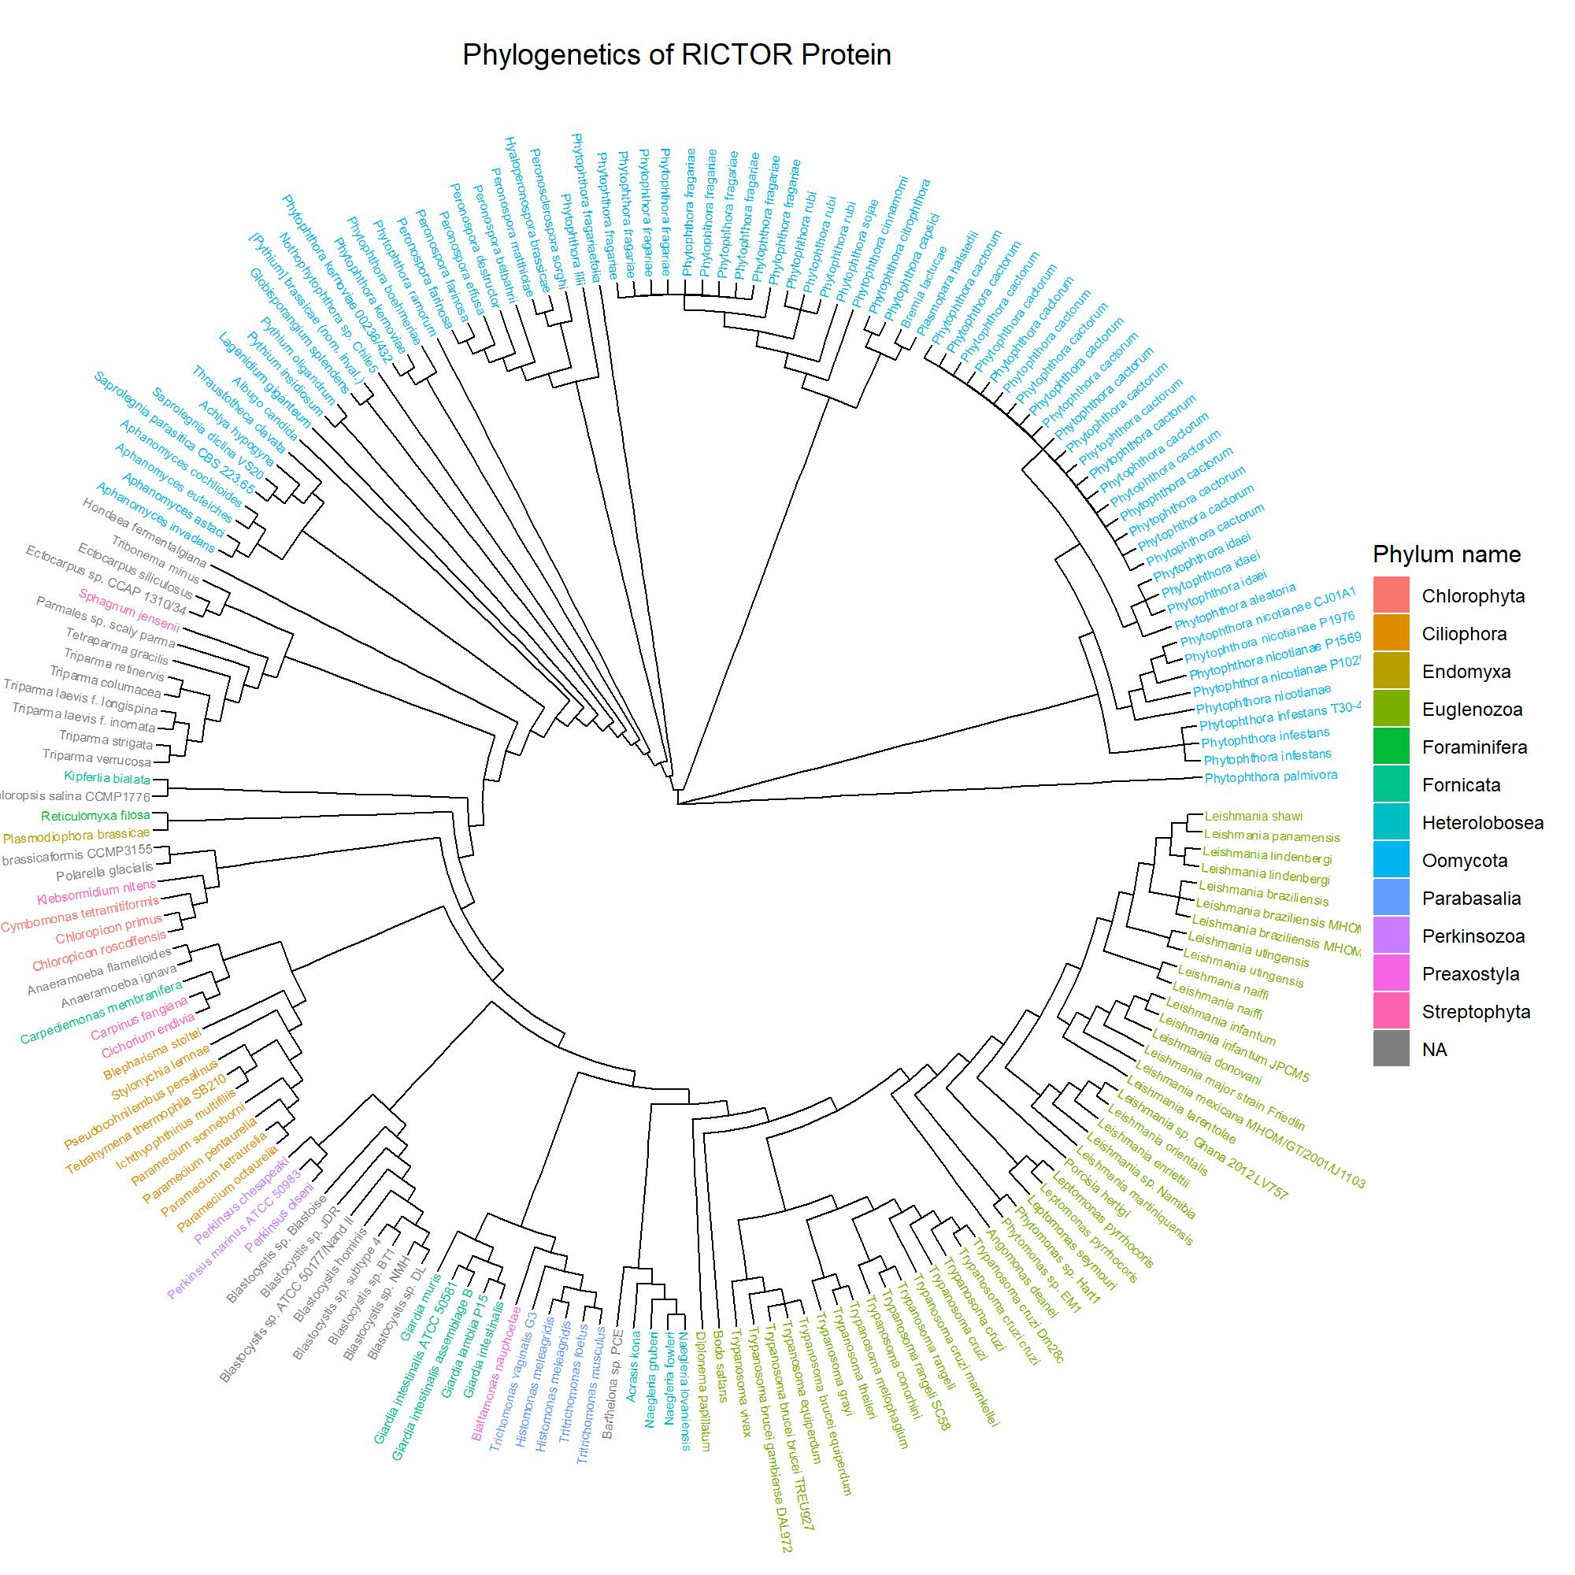
Combined Rictor Tree

Slide 10
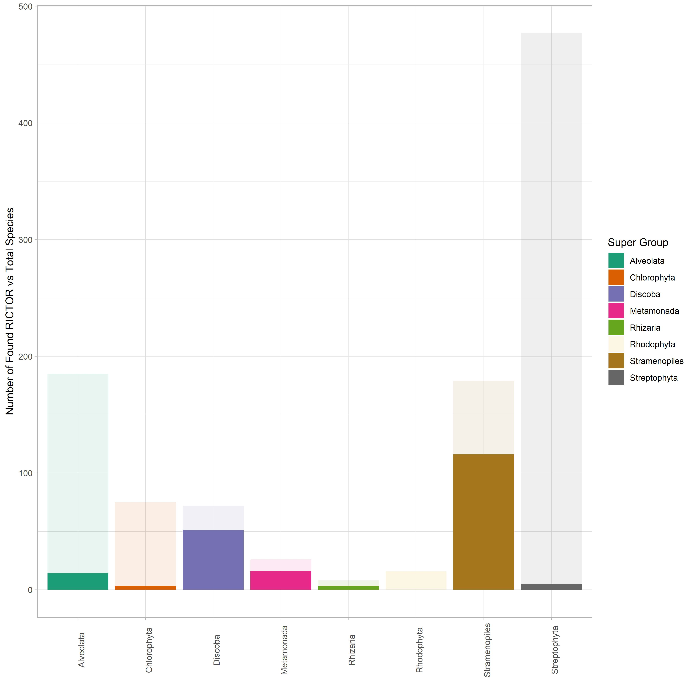
RICTOR Relative to Total Species Surveyed

Slide 11
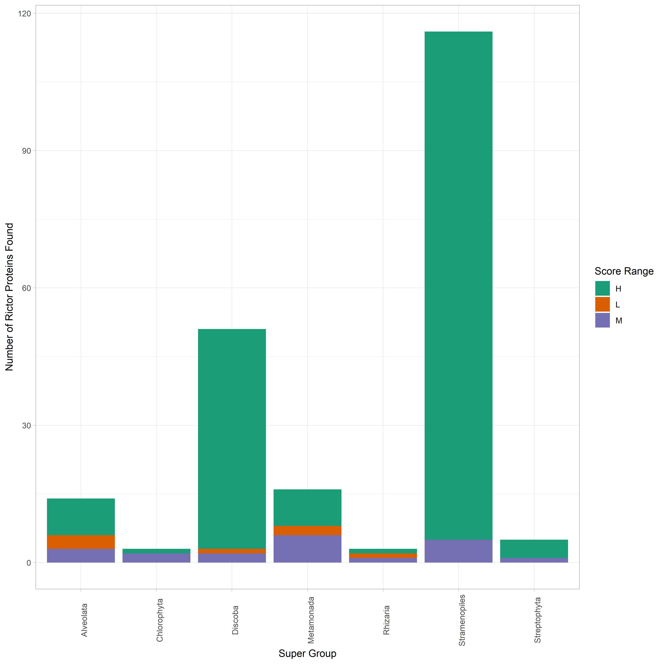
RICTOR Score Distribution

Slide 12
SIN1 Results
SIN1 much more rare in most Super Groups
Predominately in the Oomycota group (Pseudo-Fungi)
Very Prevalent within the Ciliates
Some random hits detected in Chlorophyta and Streptophyta
Further SRA analysis required to rule out their presence

Slide 13
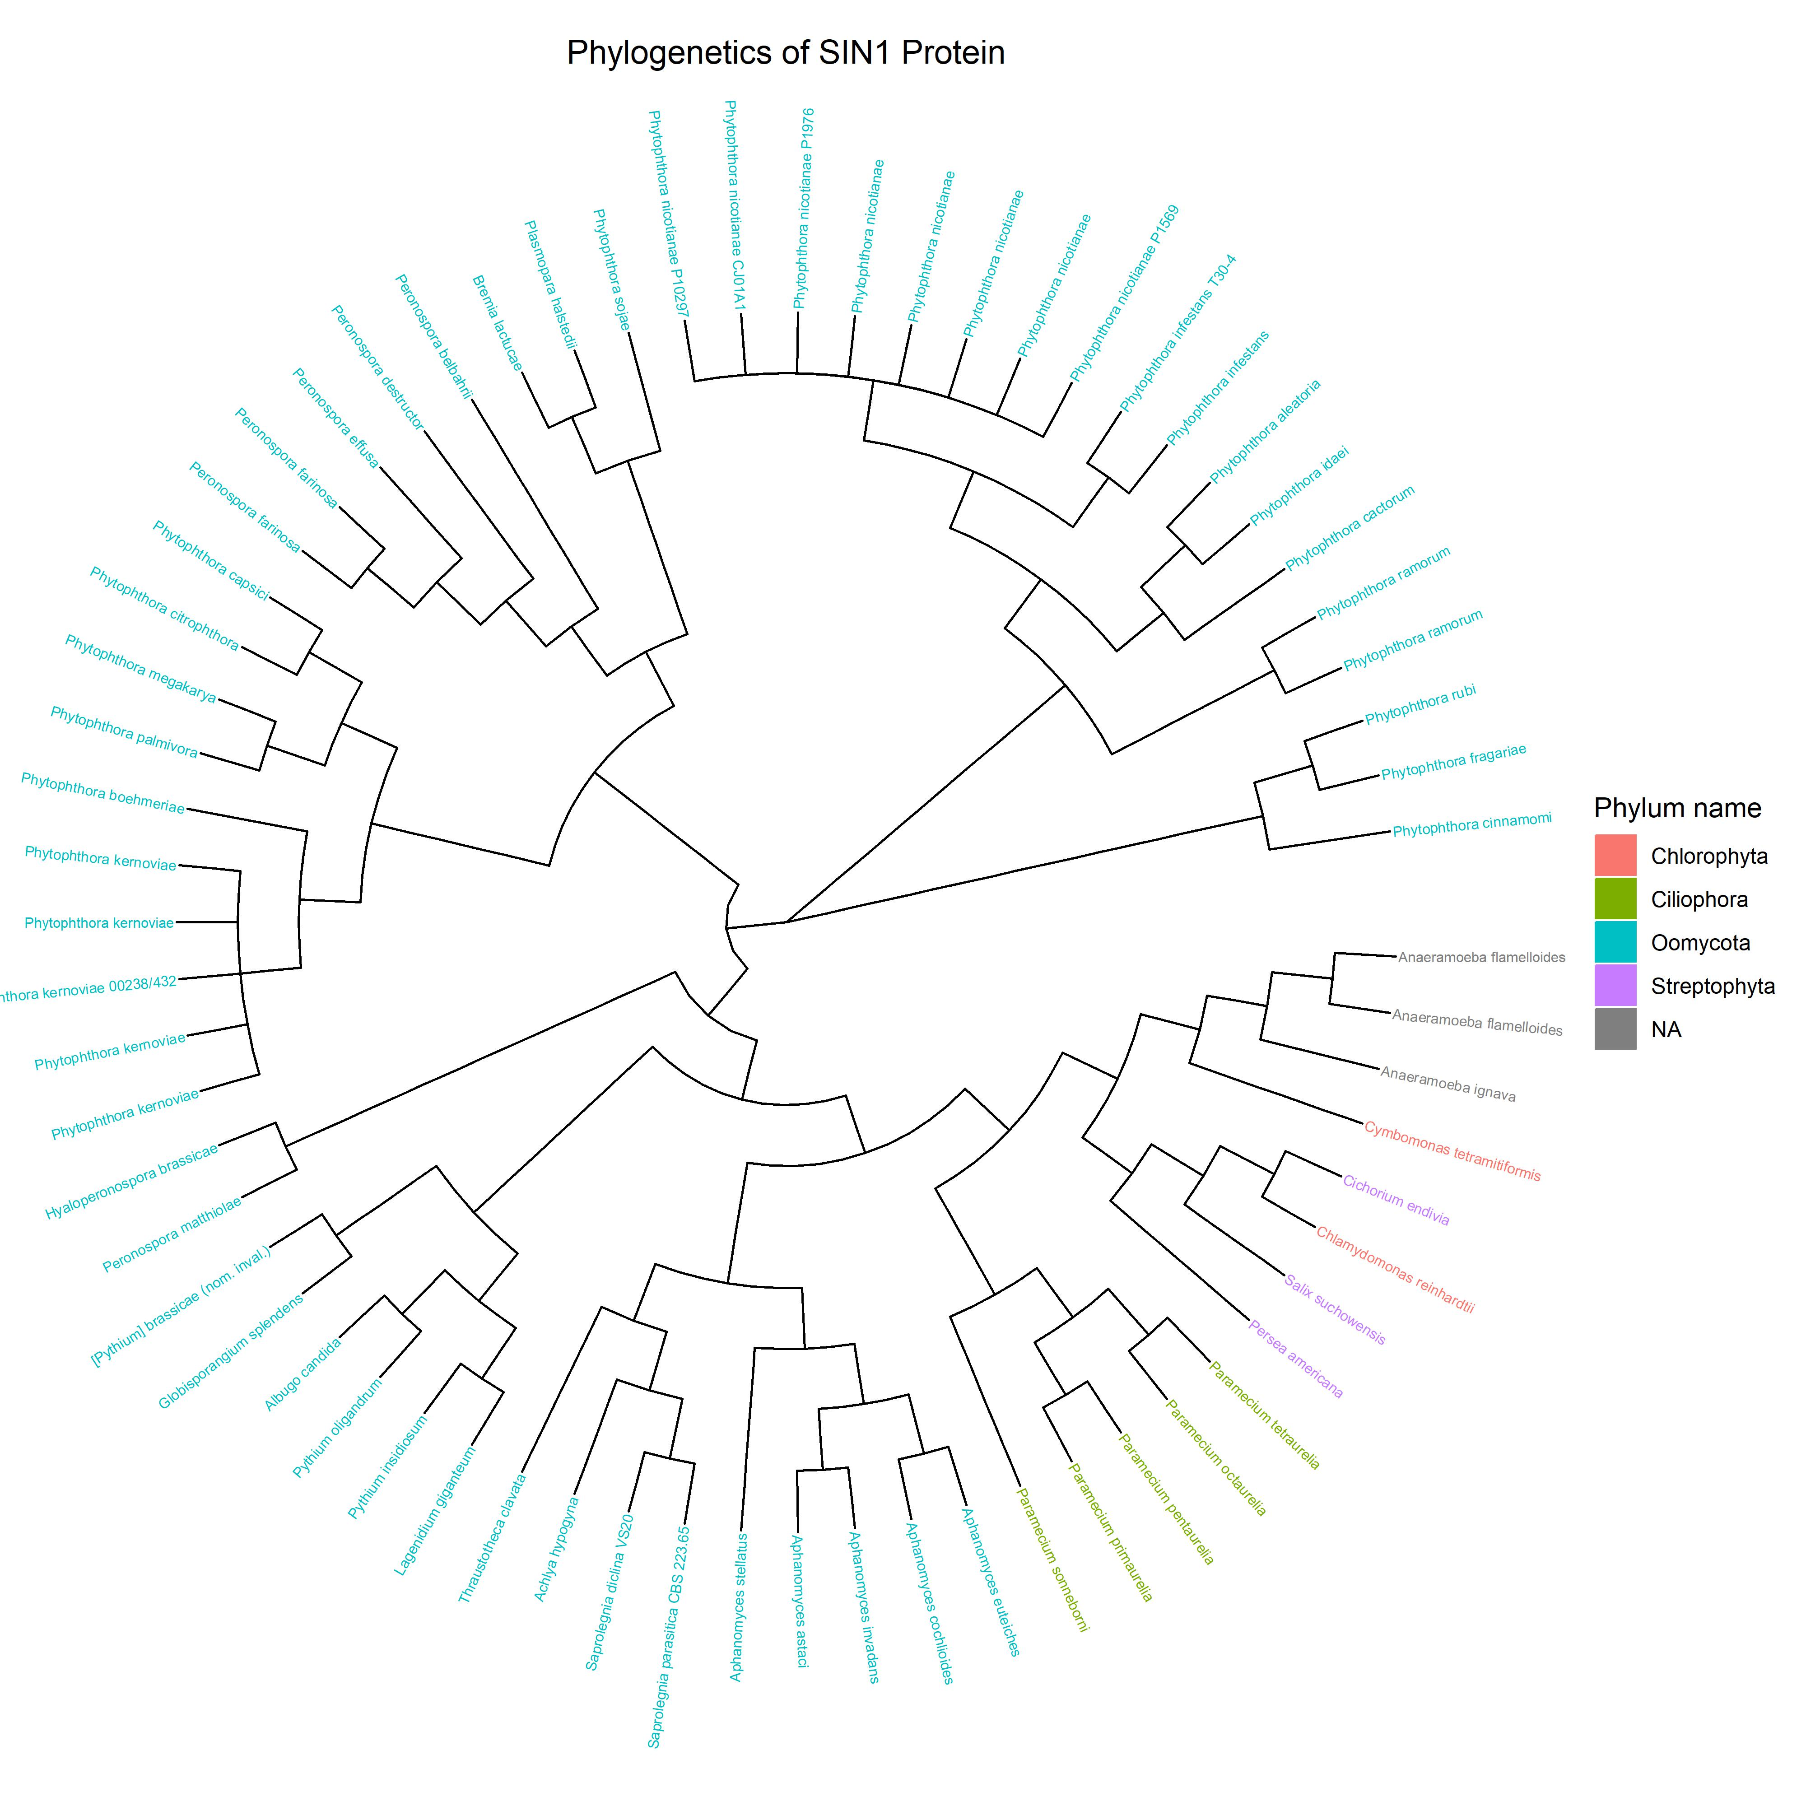
Combined SIN1 Tree

Slide 14
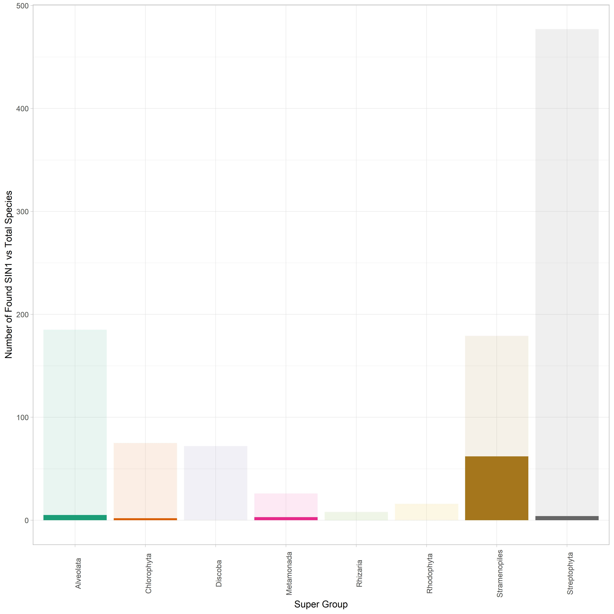
SIN1 Relative to Total Species Surveyed

Slide 15
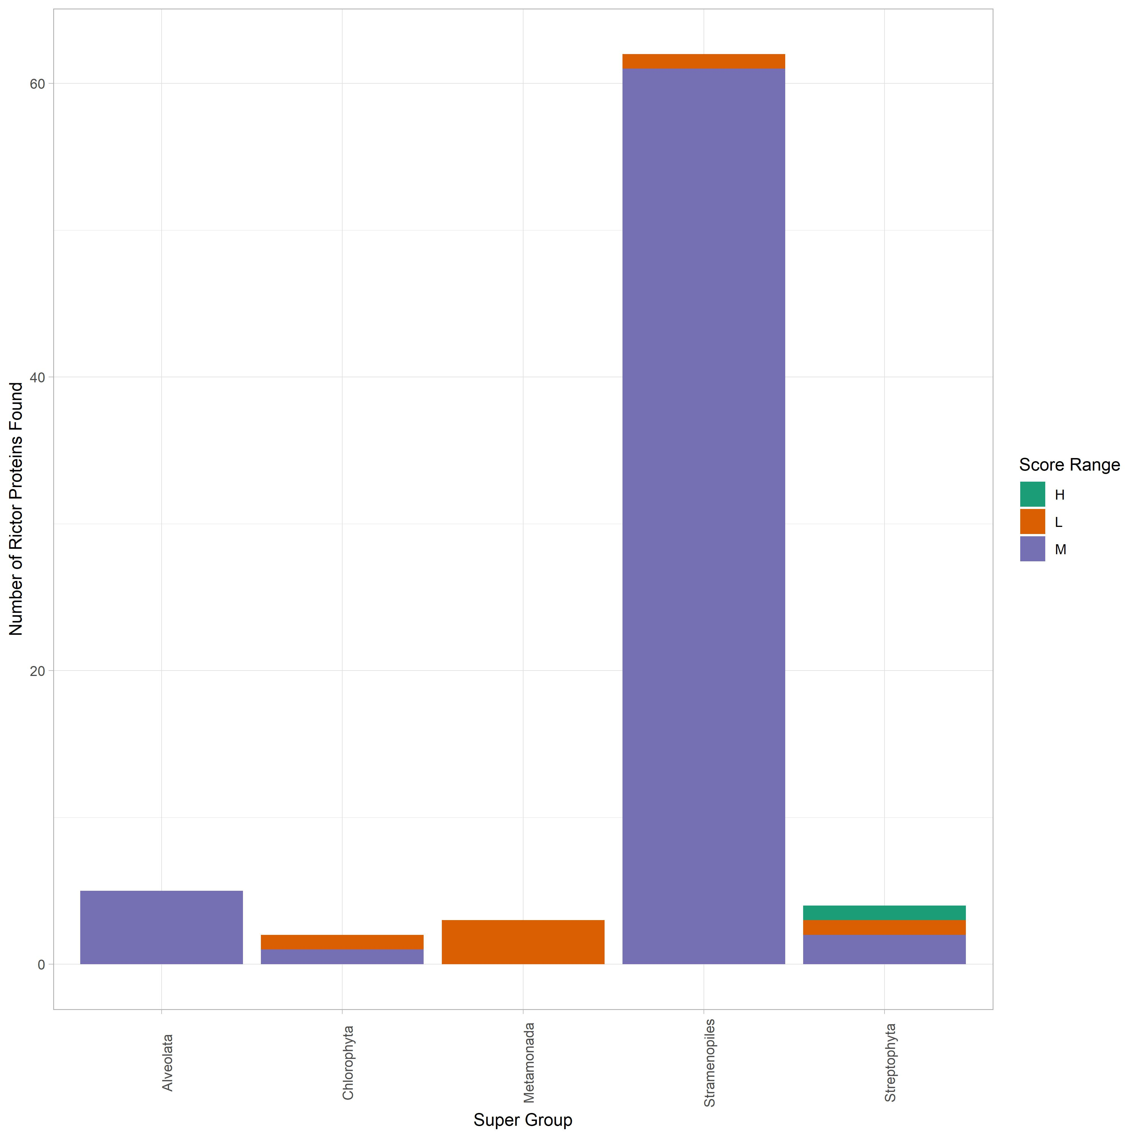
SIN1 Score Distribution

Slide 16
TOR Results
TOR found across nearly every single species sampled
Orgininally thought that all parasites lacked TOR, results suggest some remnant
Very strong clustering into Group

Slide 17
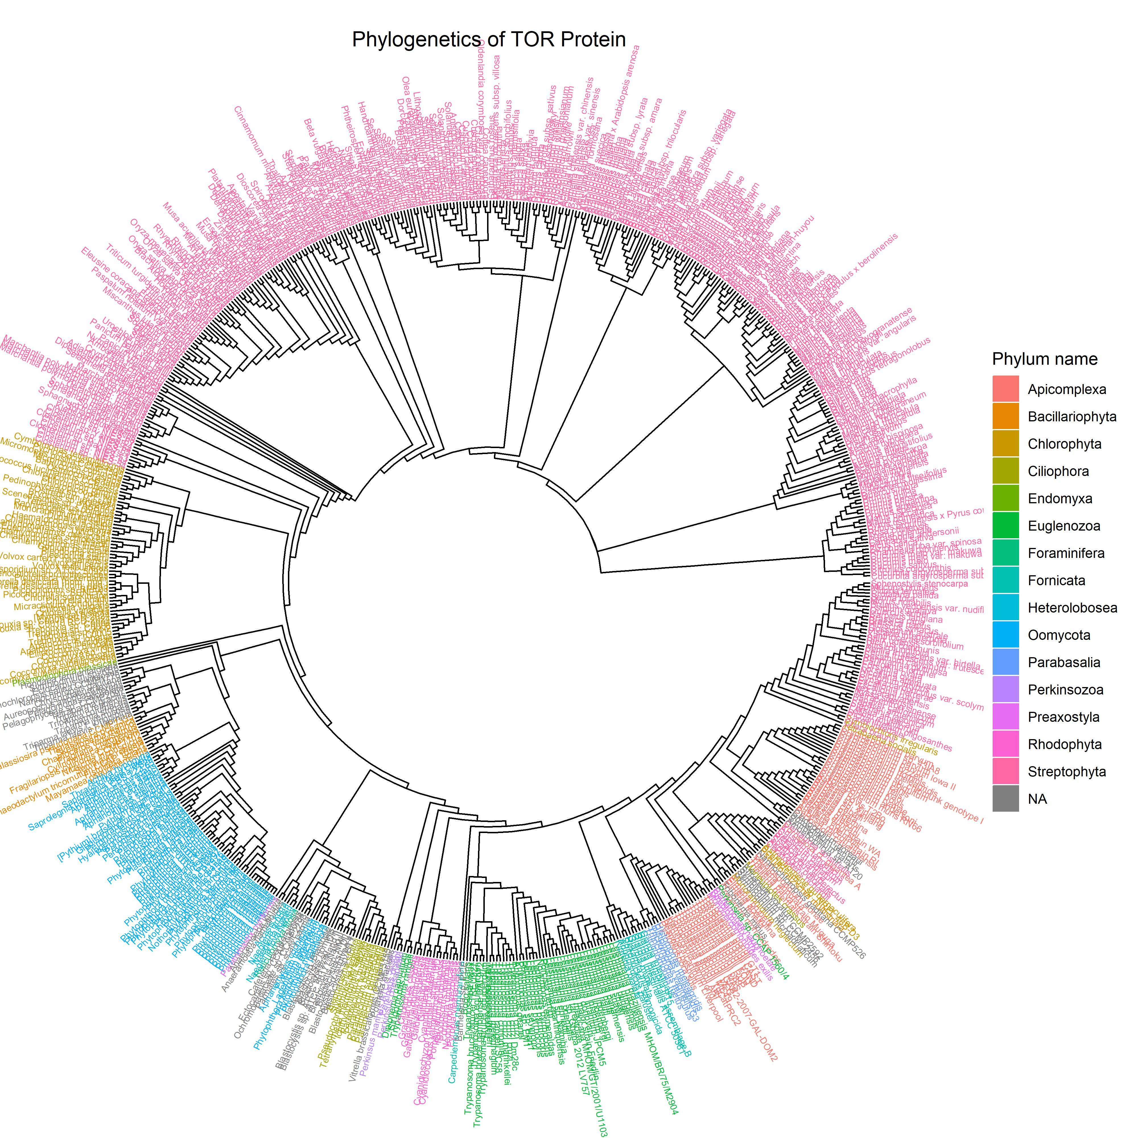
Combined TOR Tree

Slide 18
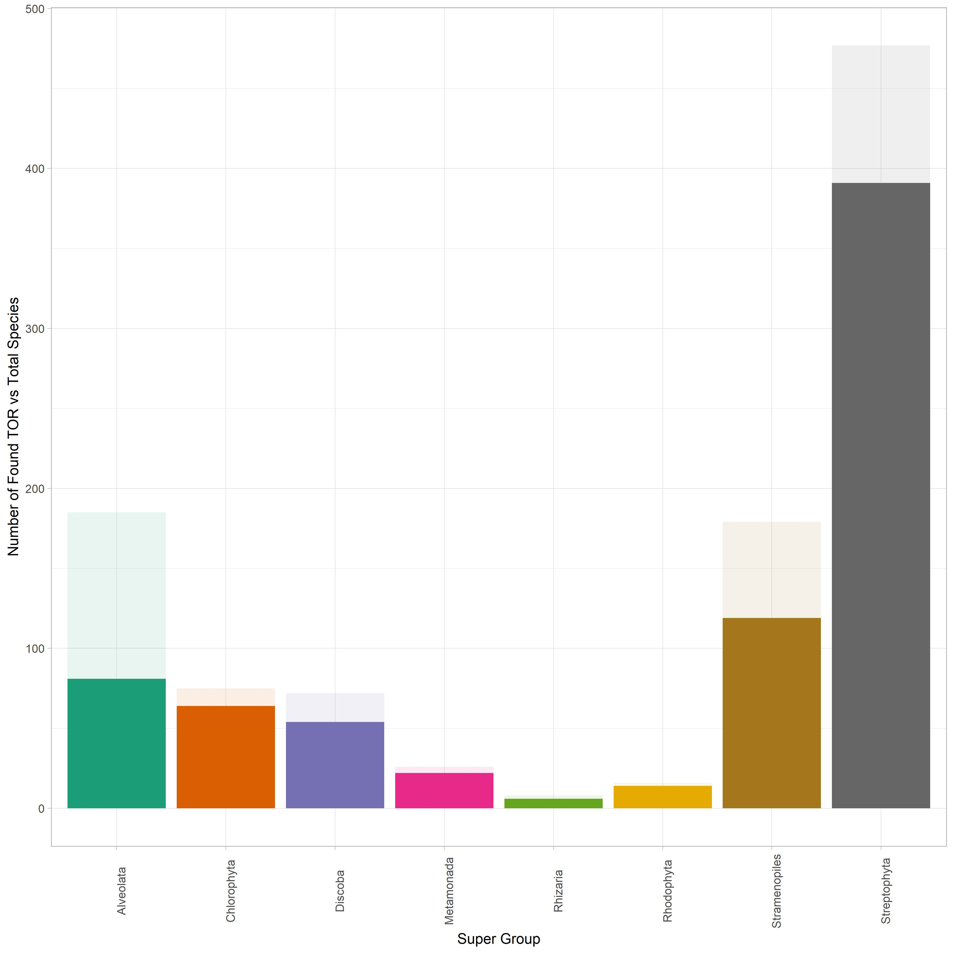
TOR Relative to Total Species Surveyed

Slide 19
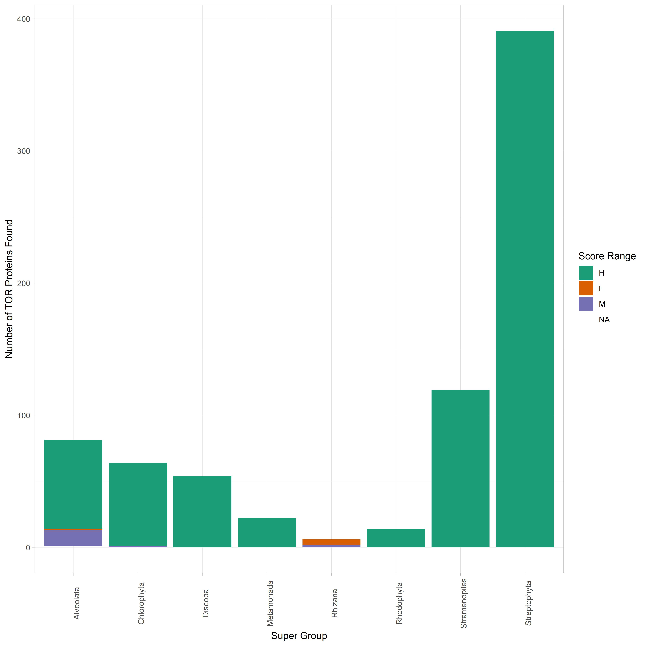
TOR Score Distribution

Slide 20
LST8 Results
Very segregated results across phylum/Super Group
Some mixing, likely due to the repeat nature of the protein
Alveolata tended to have the lowest scores overall for this protein
Parasites tend to be found in the Alveolatas, supsected reason for low score

Slide 21
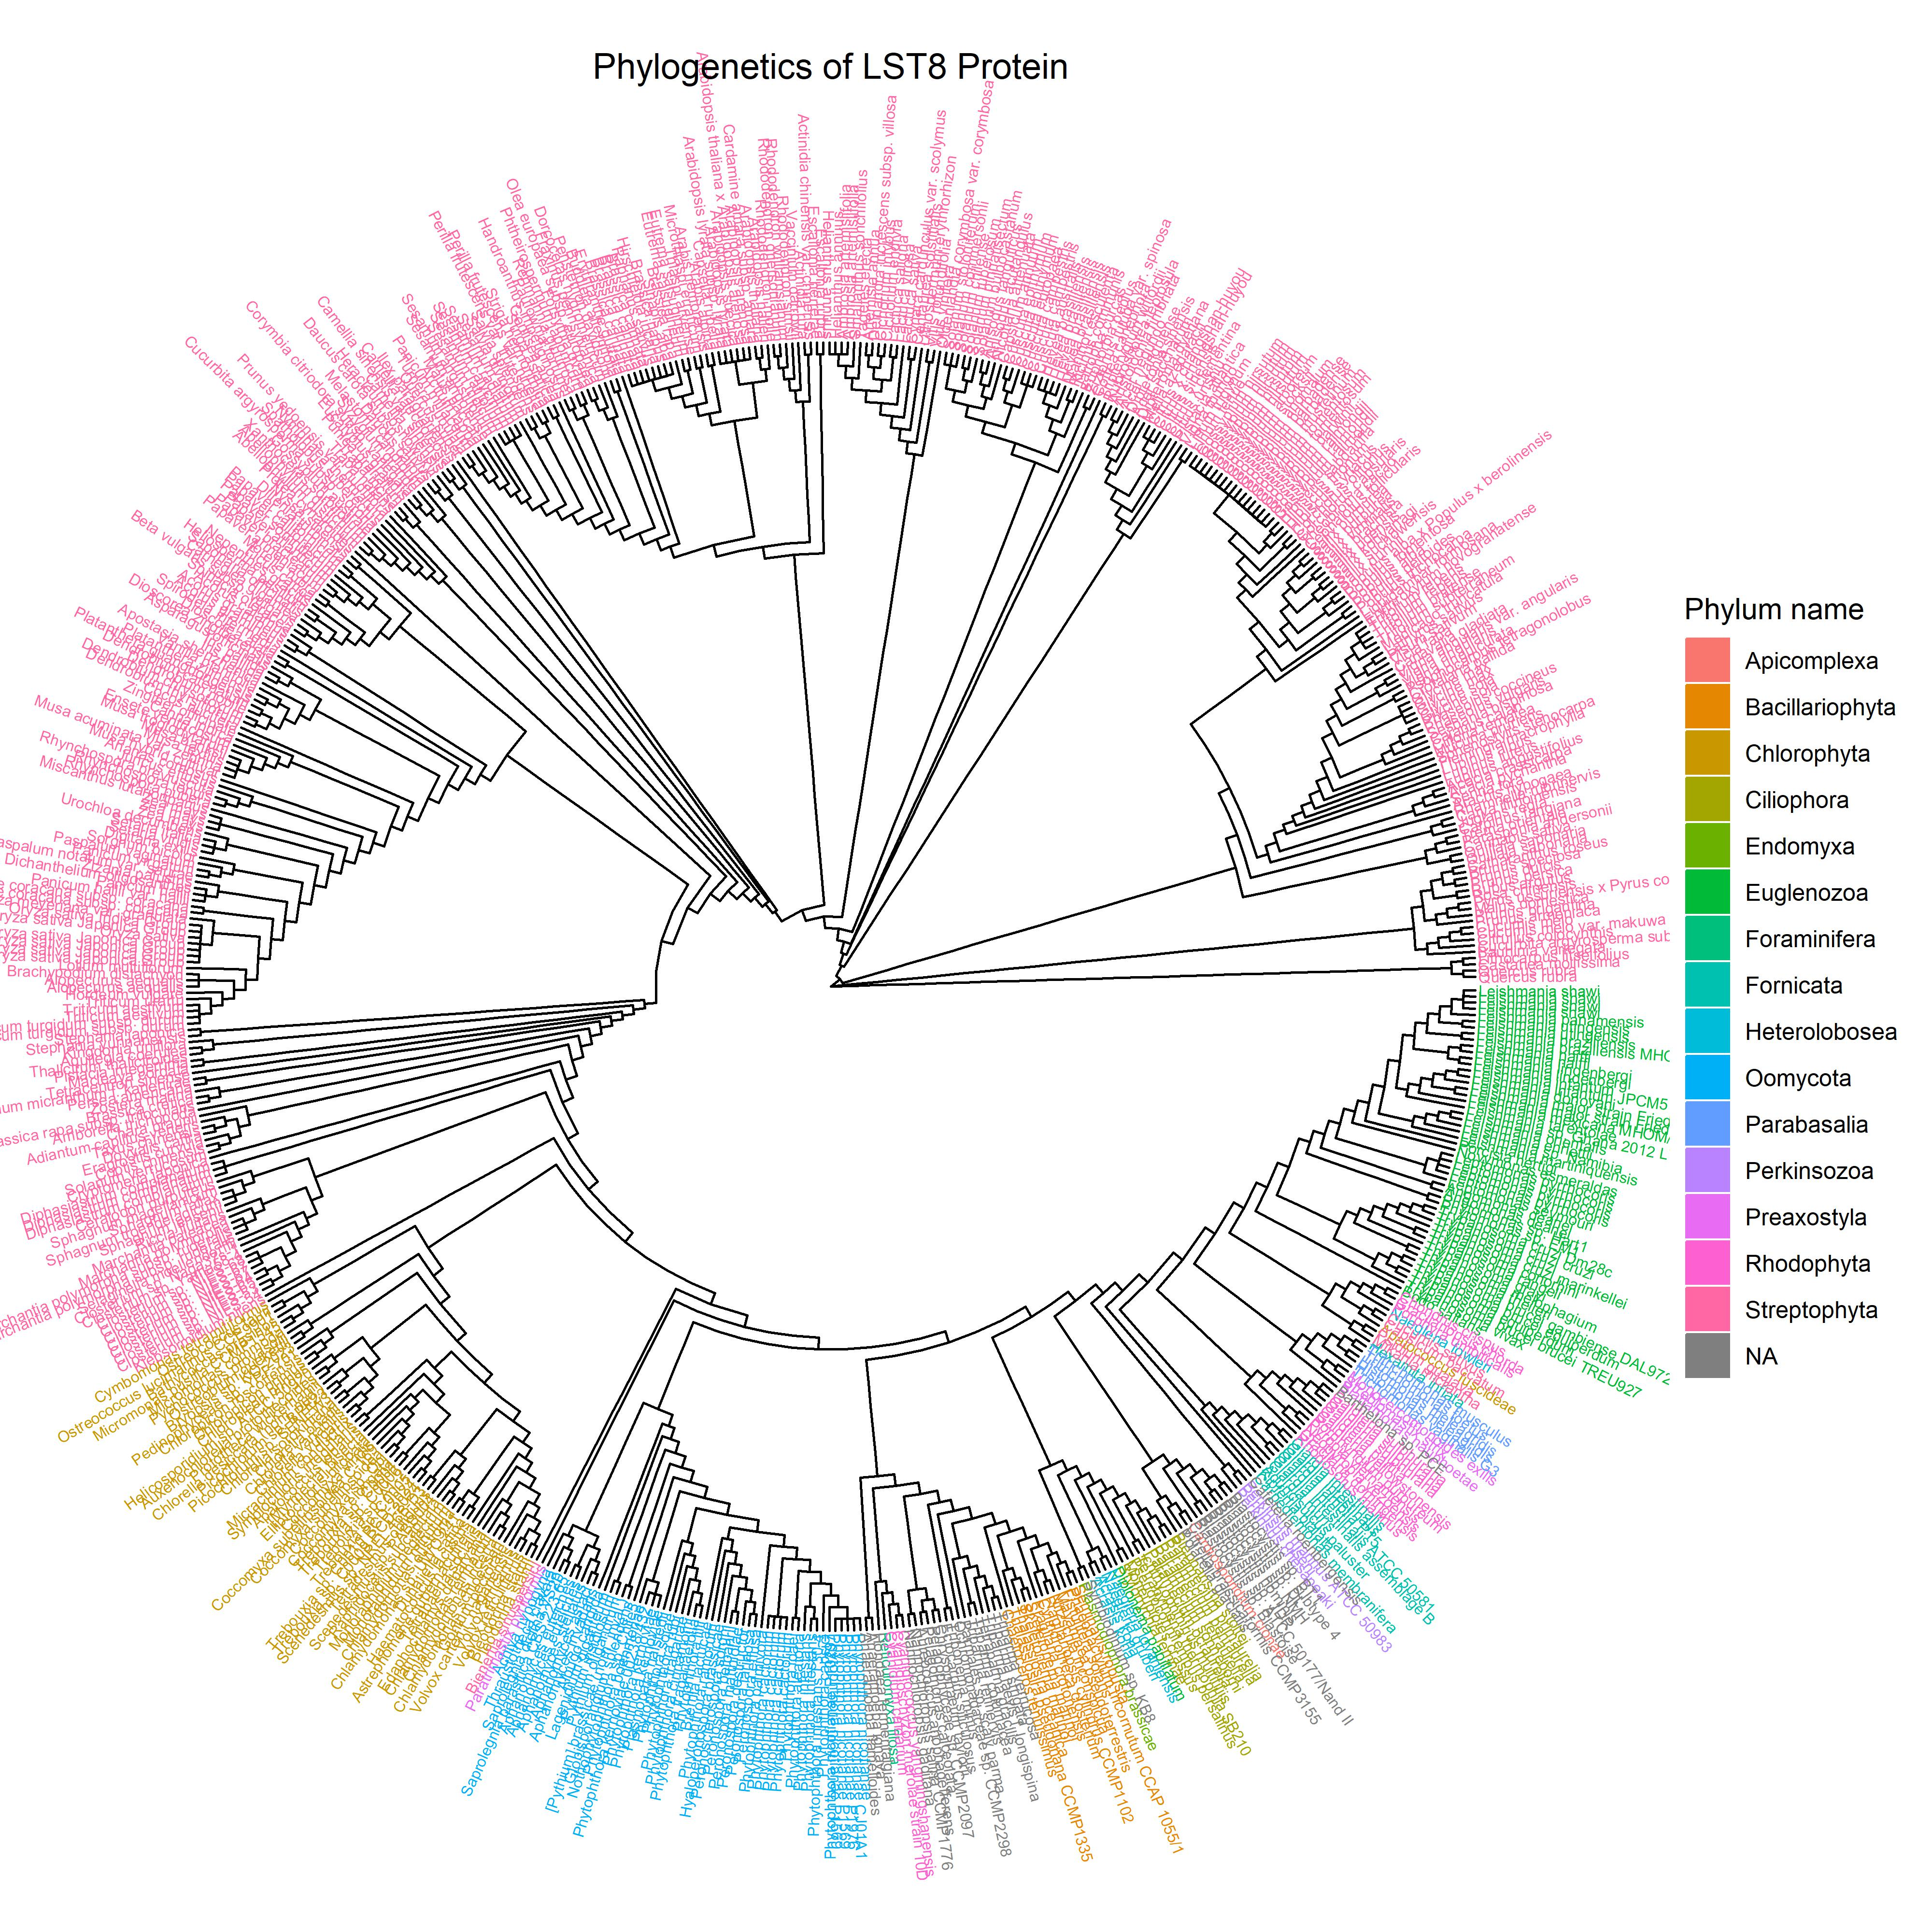
Combined LST8 Tree

Slide 22
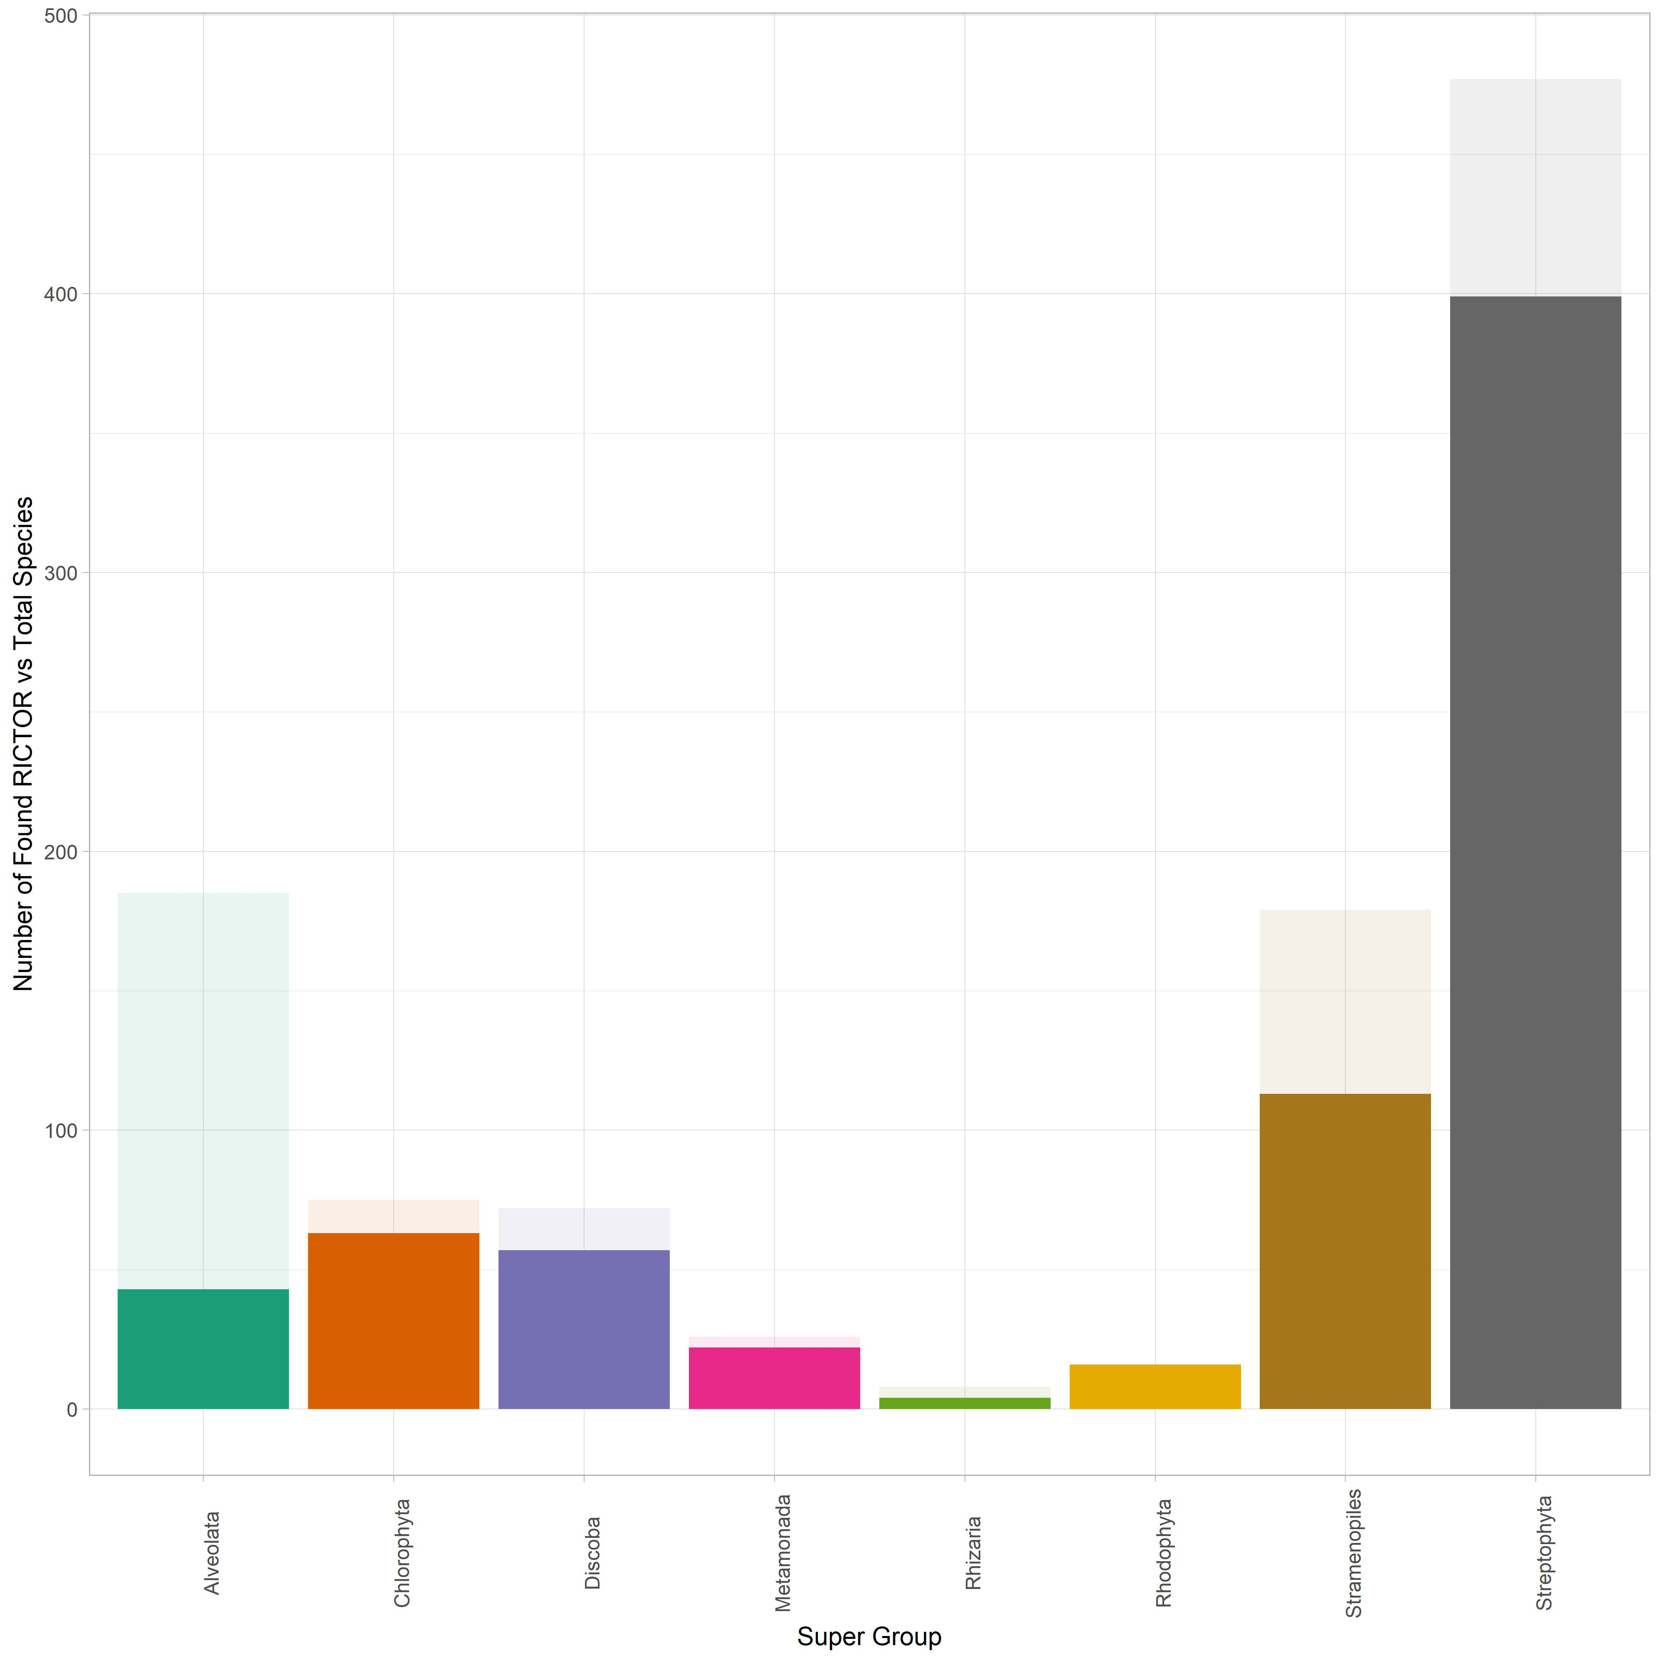
LST8 Relative to Total Species Surveyed

Slide 23
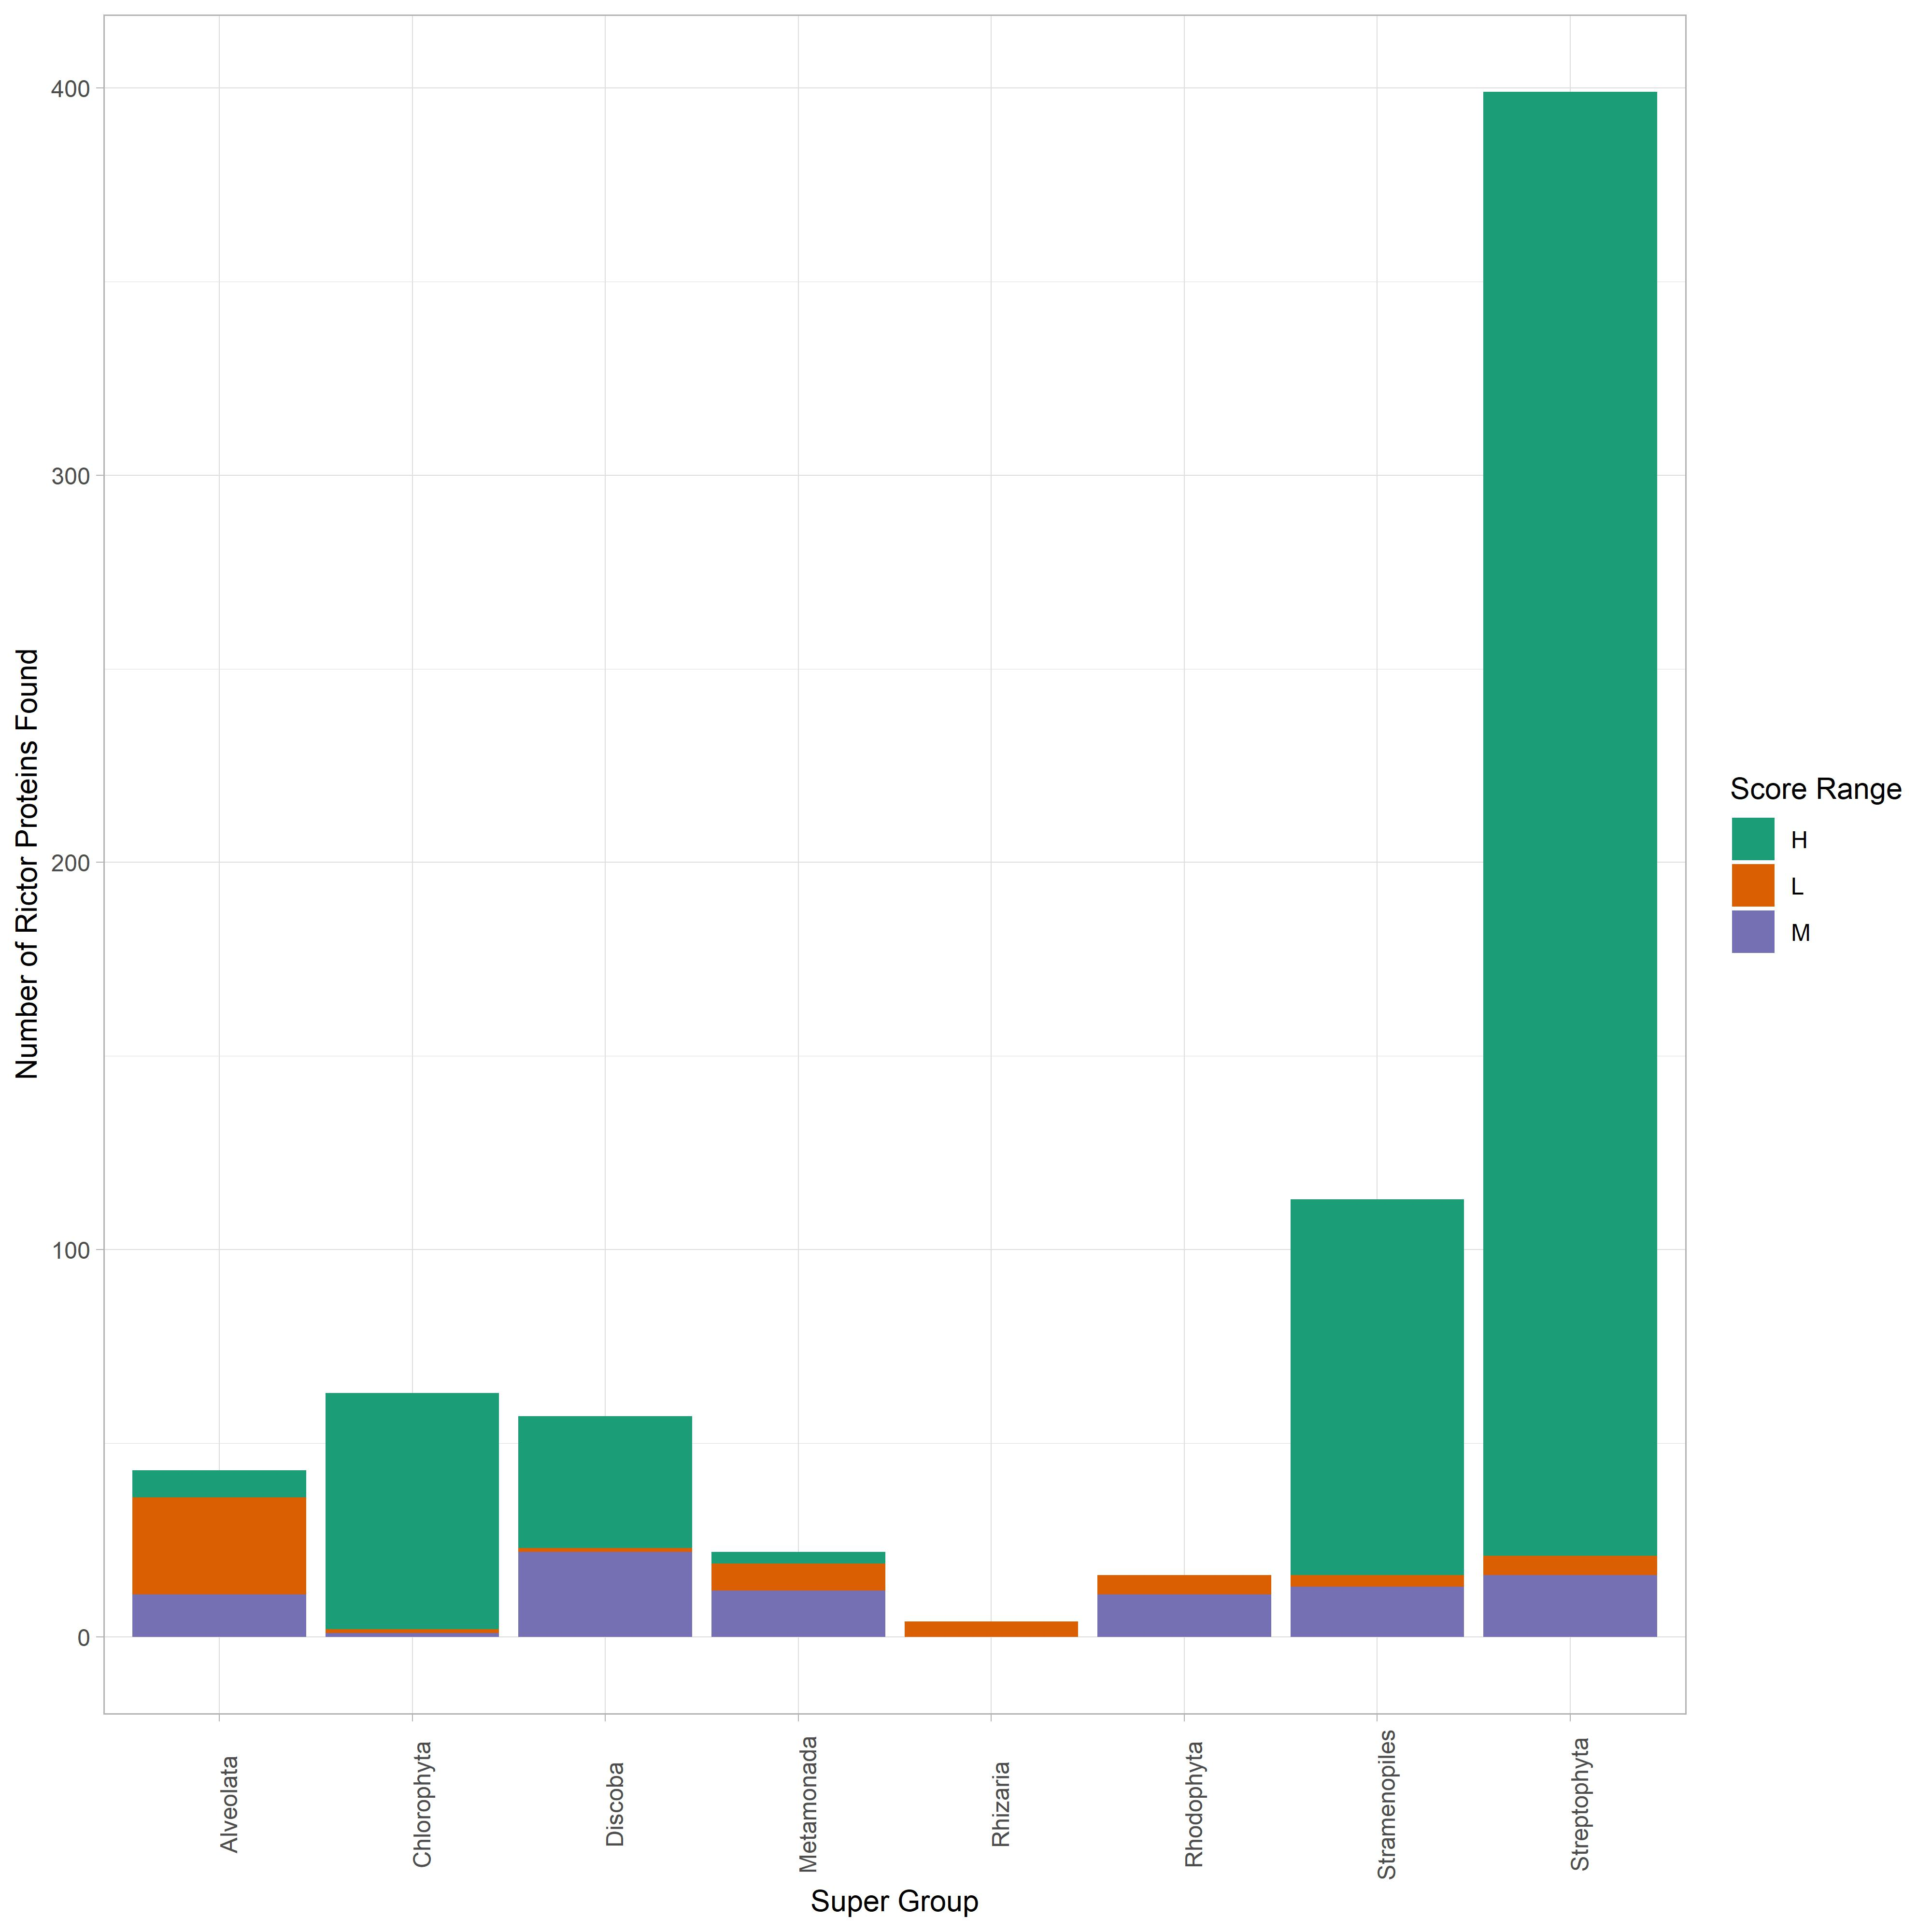
LST8 Score Distribution

